Slide 1
Yelp Data Analysis: Trends, Insights and Predictions
Team 5:
Bennett, Dylan, Neeharika, Pengru, Yahui

Slide 2
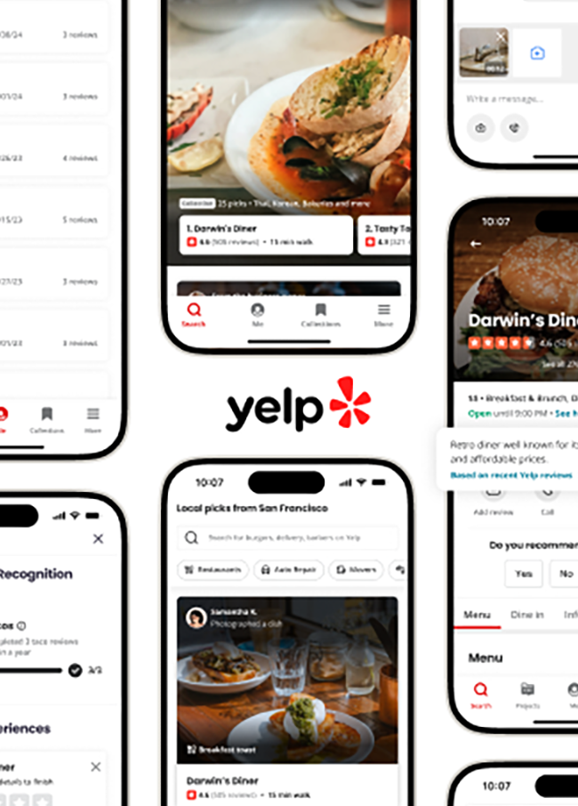
Content
Ideation
Dataset
Findings
Challenges / Limitations
Real-world Application / Future Work

Slide 3
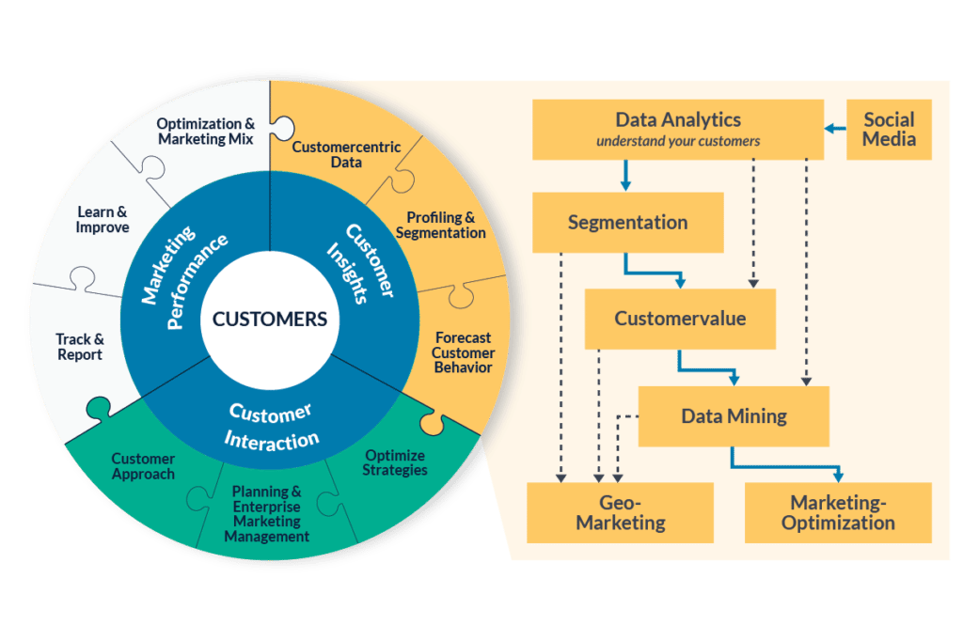
Ideation

Slide 4
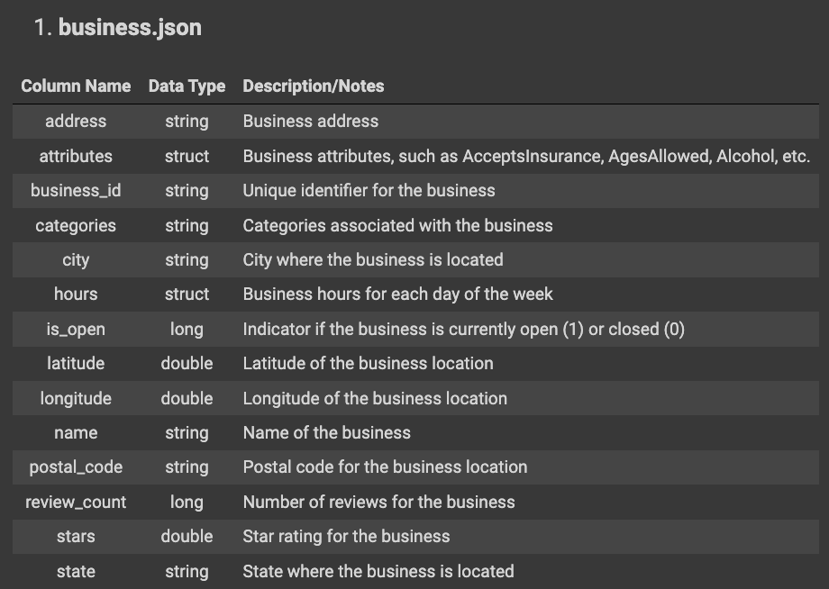
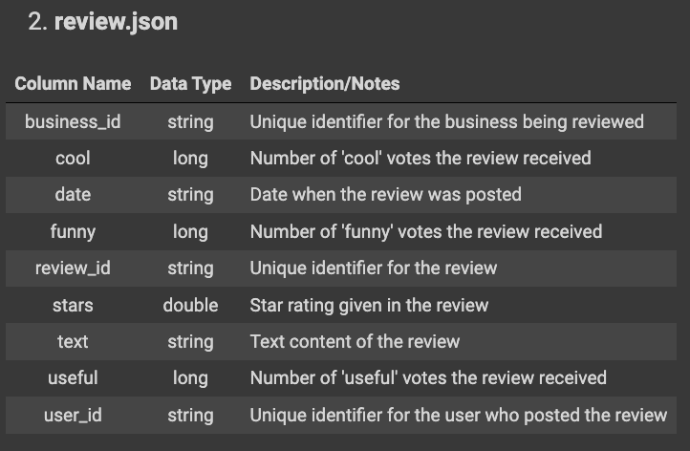
Dataset
Dataset from official Yelp website, consisting of 5 tables: business, review, user, checkin and tips.
Collectively, it contains over 6 million reviews across 150,000 businesses

Slide 5
Findings

Slide 6
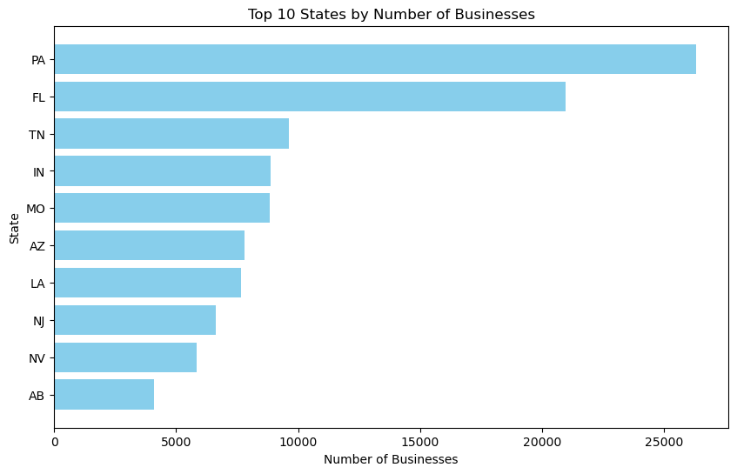
Concentration of Businesses
Notes:
Only businesses recorded in Yelp.

Slide 7
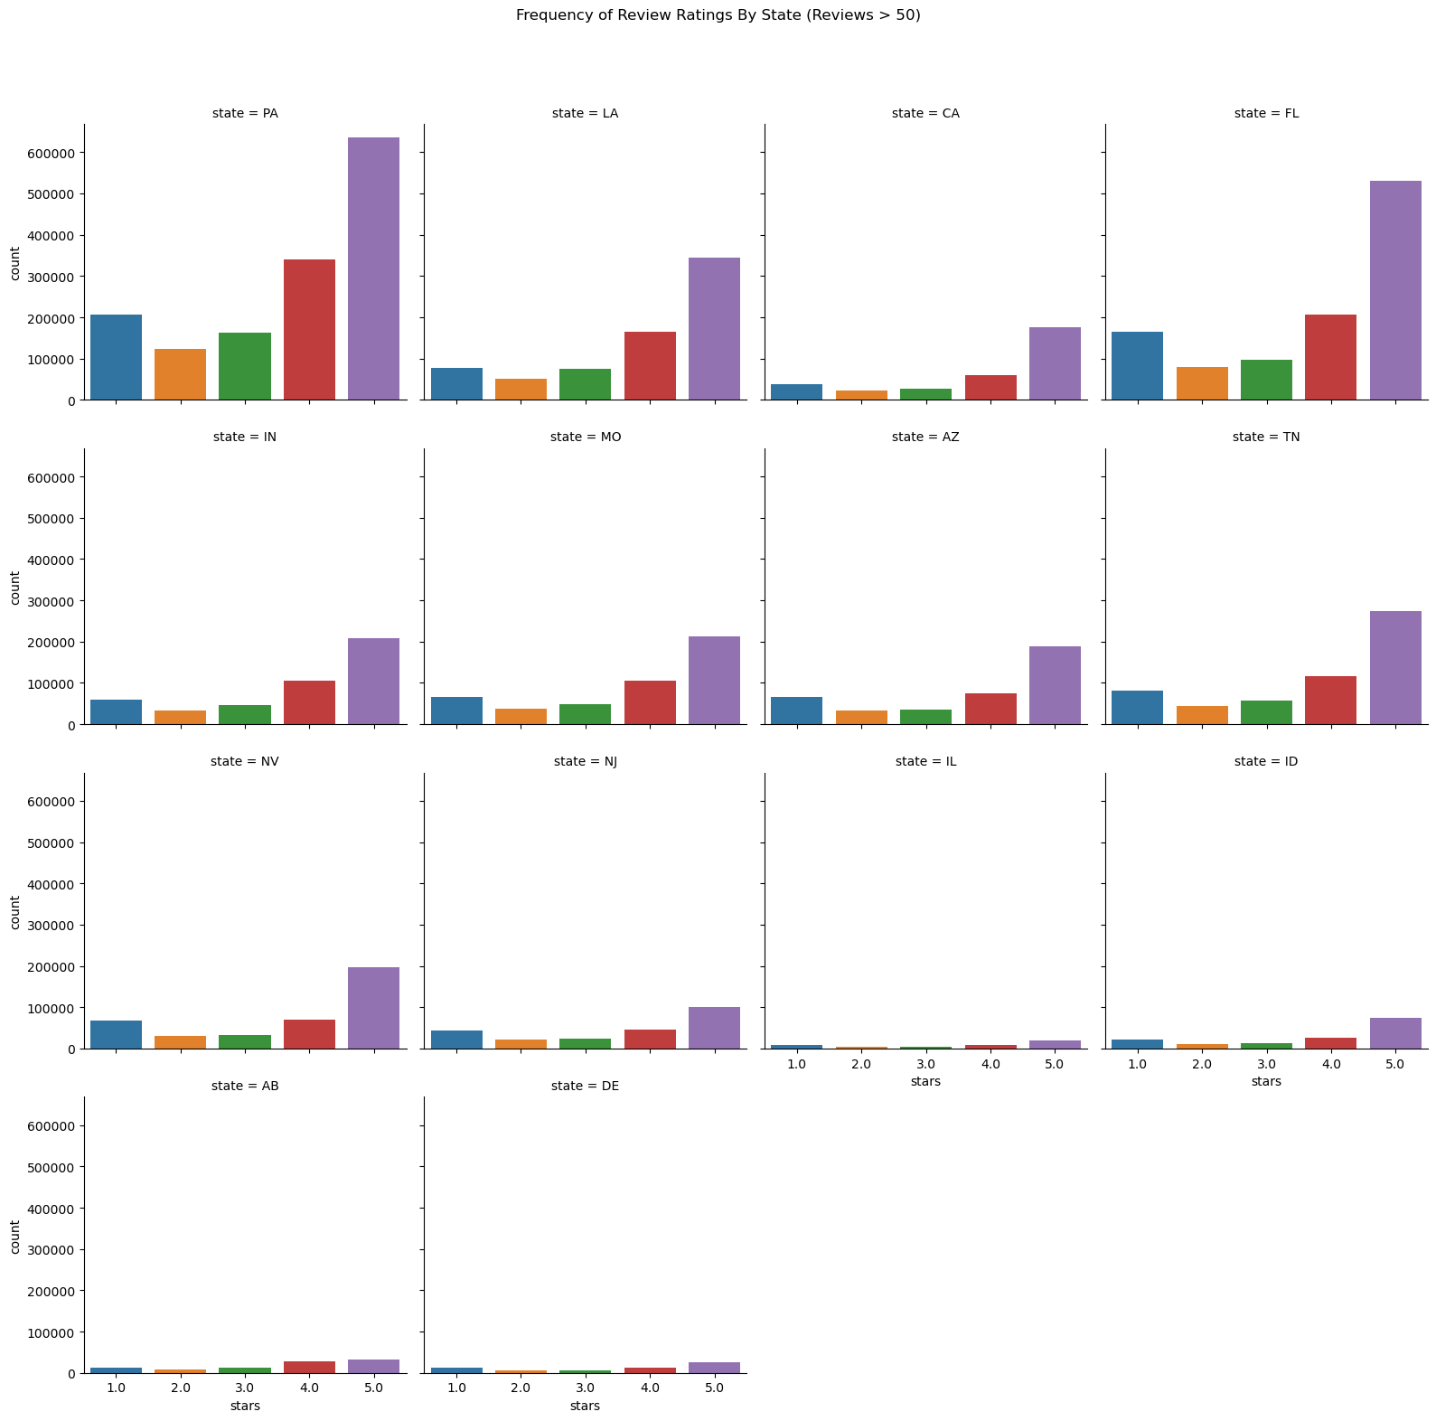
Do Ratings Vary Across States?
Generally the ratings for all businesses within a state seem to follow the same distribution
States may be too broad of a category to derive meaningful differences across business reviews

Slide 8
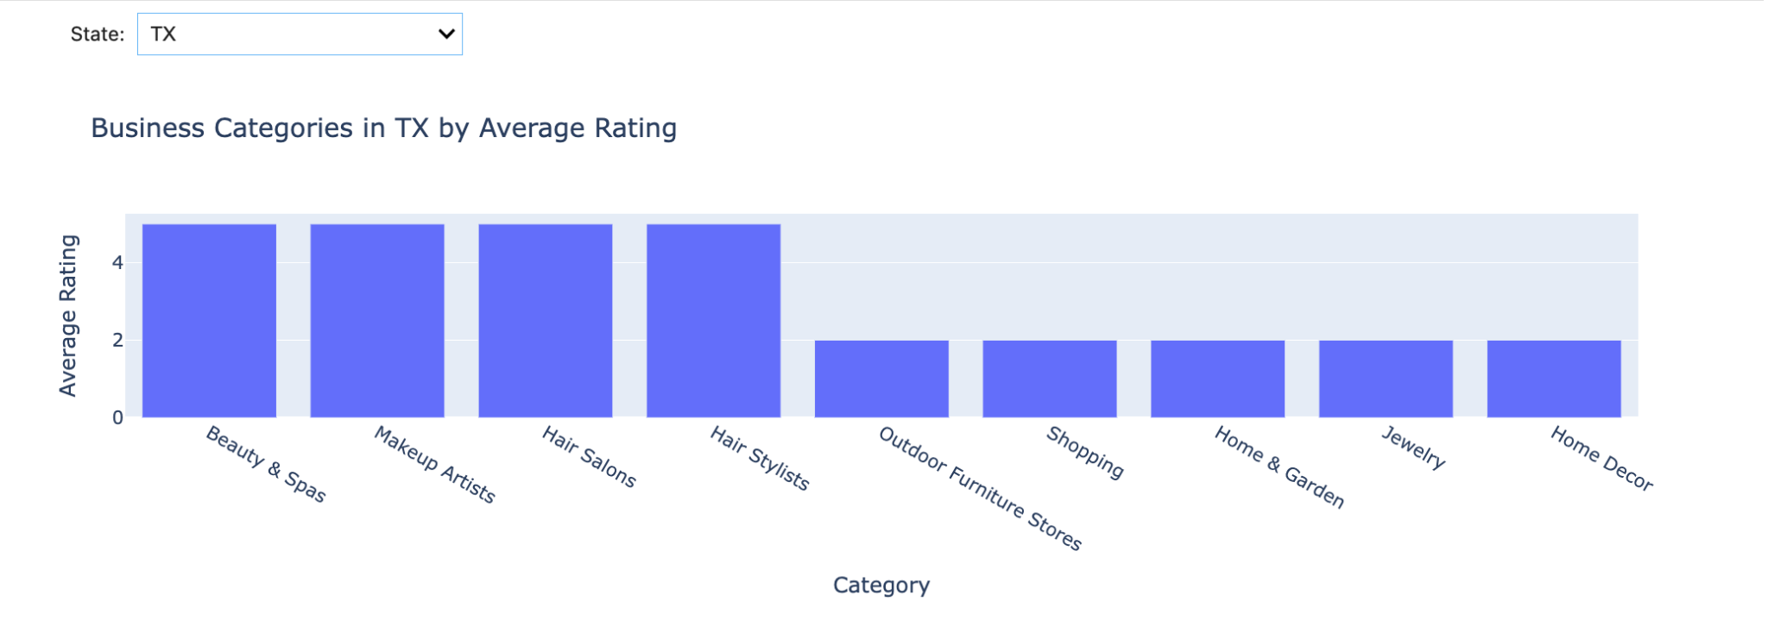
How different categories are appealed in different States?
In Texas, Beauty and hair services are the most liked based on their average ratings, whereas home decoration related services are found to be least liked by the public.

Slide 9
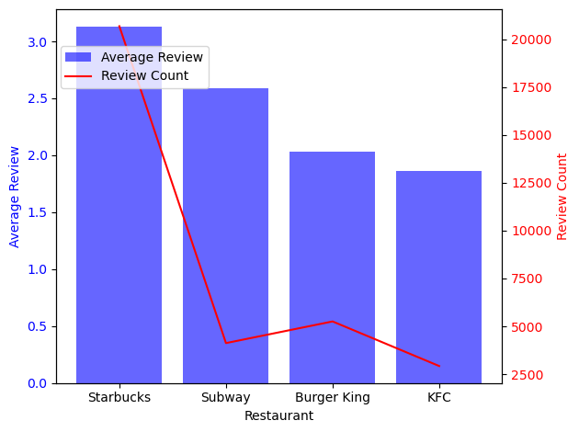
Are fast-food chains slowing down in popularity?
Low Average Ratings: Across major fast food chains, average user ratings are generally low.
Starbucks Exception: Despite its prominence, Starbucks only achieves a slightly above 3-star rating.
Perception Challenges: Fast food is convenient but raises concerns about nutrition and health.
Balance Opportunity: Restaurants can improve by balancing speed with quality.

Slide 10
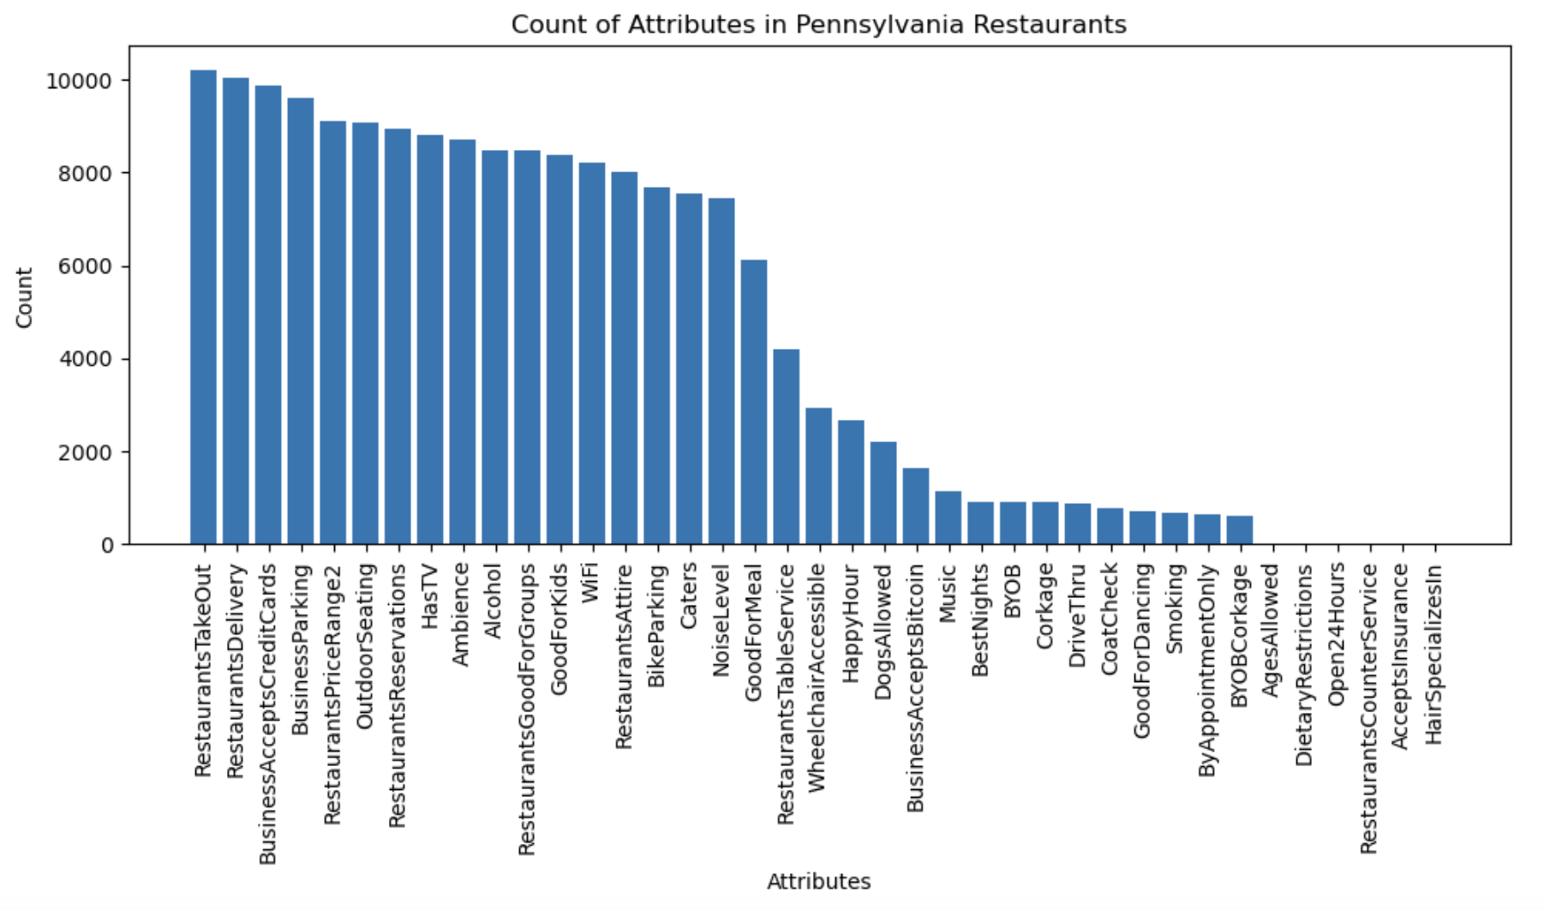
Distribution of Attributes in PA’s Restaurants
Strong preference for convenience service among customers in Pennsylvania
Potential areas of under-serviced markets or opportunities for differentiation
New restaurant owners in Pennsylvania might consider prioritizing features like takeout, delivery to align with prevalent customer preferences

Slide 11
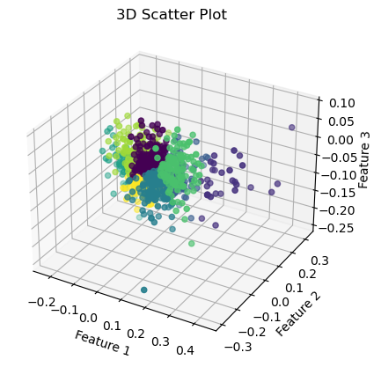
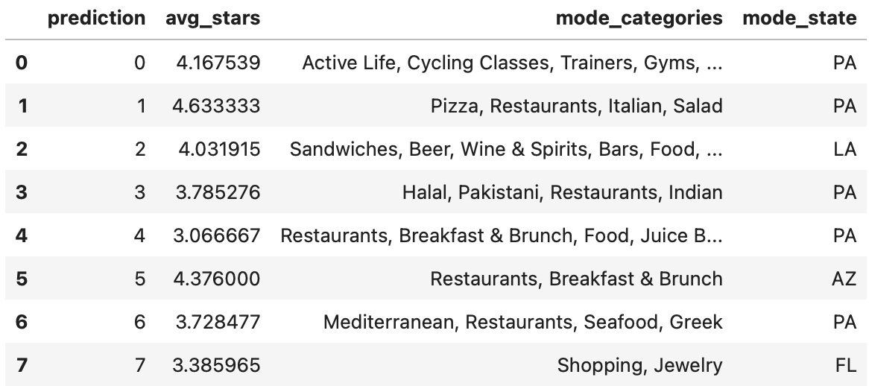
Generalizing with Clustered Embeddings
Reviews (Text)
Preprocess (Regex & Tokenize)
Word2Vec (embedding length = 100)
K-Means (k = 8 elbow method)
PCA (components = 3)

Slide 12
Challenges / Limitations
Categories are too Specific
Computational Cost
Each business contains a list of categories, making it very difficult to generalize
Creating embeddings for all 10gb of text is extremely memory intensive
20 CPU limits for Dataproc Clusters
Limited Resources in Pyspark ML
Generalizability
The Pyspark ML library does not have access to more robust NLP and dimensionality reduction methodologies, resulting in less meaningful insights
Yelp
The Yelp academic dataset is only a subset of the entire yelp ecosystem, making it difficult to generalize results and findings.

Slide 13
Real-world Application
Identify Optimal Location
Optimize Service Attribute
help new business owners determine the best locations to open their businesses
help new owners optimize their business services to match what specific services customers value
Understand Customers’ Preferences
Target Optimal Business Category
help new owners understand what aspects of a business are most important to their potential customers
help new owners to figure out what kind of business have the potential to be successful

Slide 14
Future work
Advanced Predictive Modeling
Real-time Data Integration
Sentiment Analysis Enhancement
Utilize different machine learning methods to implement prediction
Apply deep learning models to our project
Analyze data in real-time to receive updated insights
Help to react quickly to changes in customer preference and competitor activities
Help new business owners understand their target audiences better
Help to improve marketing strategies for business owners

Slide 15
Thank you

